Slide 1
Team mandarine
Presents:

Slide 2
Project
Movies statistic app

Slide 3
The goal of the app is to draw charts based on given data.
We succeeded to implement 9 different charts.

Slide 4
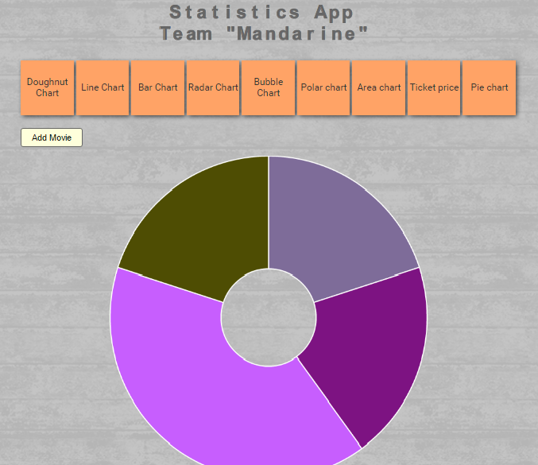
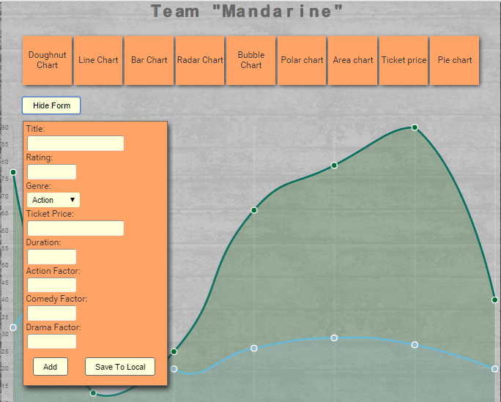
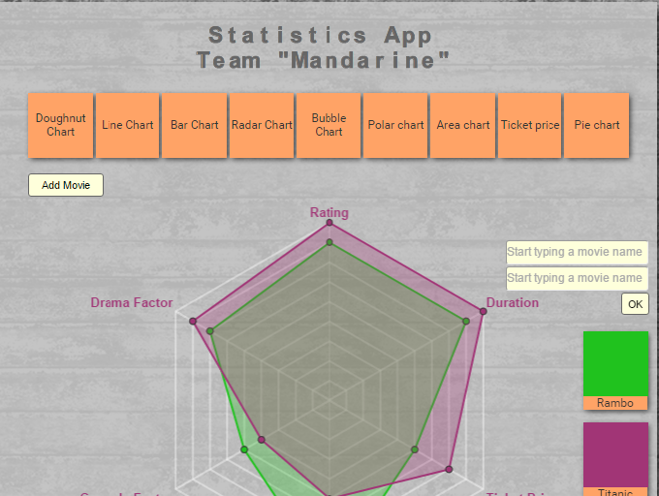

Slide 5
The theme of the app is movies. It has its own database, which is used to create the chart.
You can also add a movie with detailed info – genre,
ticket price, drama factor etc and it’s added to the database. Some of the charts can work with the new information.

Slide 6
General Requierments: - used HTML5 canvas, chart.js, kinetic.js - used SVG frameworks Raphael js, Highcharts - we have animated team and project names - the app works correctly in Chrome, Firefox, Opera, Apple Safari

Slide 7
Optional Requierments:
- used correct naming - used modules and OOP - Strong cohesion and loose coupling
- used GIT as a source control system, the project is hosted there.

Slide 8
Repository address: https://github.com/kidroca/JS-Teamwork-Mandarine

Slide 9
People, who took part in the project: Petar Velkov – kidroca Yordanka Petkova – yori_to Ivan Ivanov – Arcelion Todor Dimitrov – TodorDimitrov Peruna Keremidchieva – peruna Svilen Ukalski – snukal Hristo Vasilev – vasilevhr Nikolay Kumanov – NP.Kumanov Filip Anestiev – panestiev
People, who took part in the project: None

